Slide 1
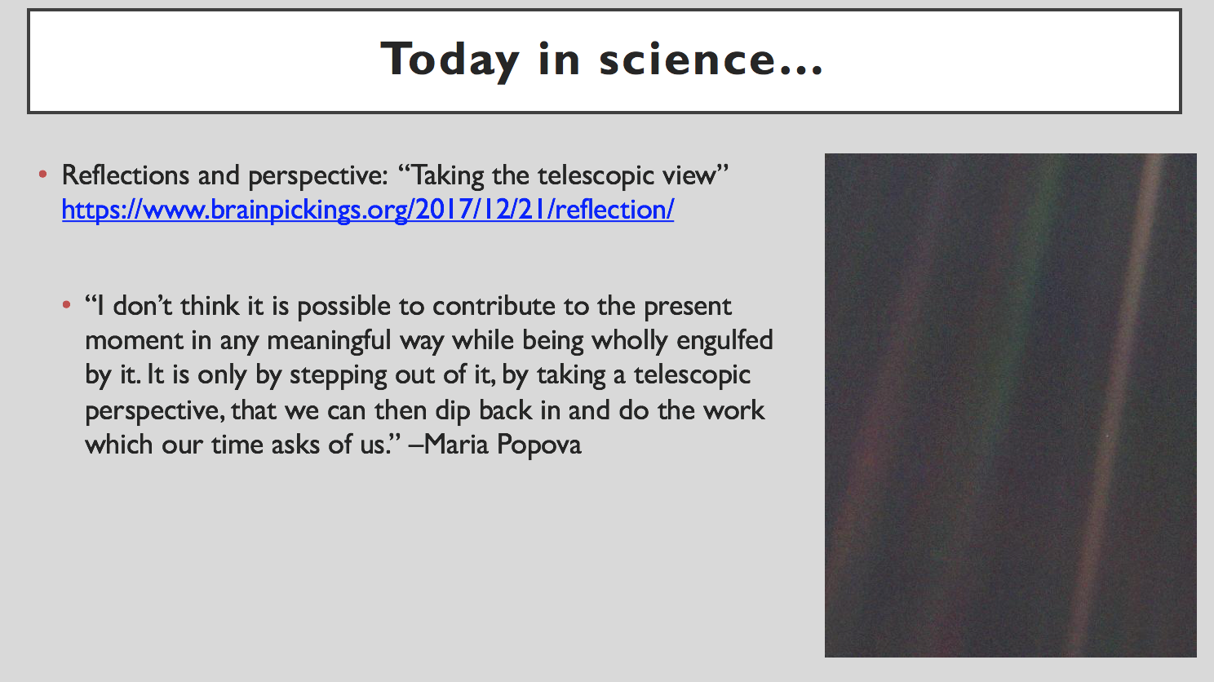
A brief aside… on neurodiversity, and errata
Last class, I was talking about Voyager (again), the Golden Record, and the pioneer plaques
I mentioned the Vitruvian Man as appearing on the plaque. I was wrong about 2 things
1. It wasn’t the Vitruvian Man, it was just a cartoon of a man and a woman
2. I said Michaelangelo’s Vitruvian Man- obv, that was da Vinci
I think there’s a point to be made here about how our brains work, and understanding how we approach learning, both in our chosen disciplines and outside of them
Notes:
I think this is just a really quintessential demonstration: what’s obvious to you (art and Classics majors.. Yes duh it was da Vinci, ugh Prof A) is not obvious to me, and what’s obvious to me (hmm, a star far enough below the equator shouldn’t be visible to us in the northern hemisphere..) may not be obvious to you. Our brains work in different ways and excel at different things, and that’s cool!

Slide 2
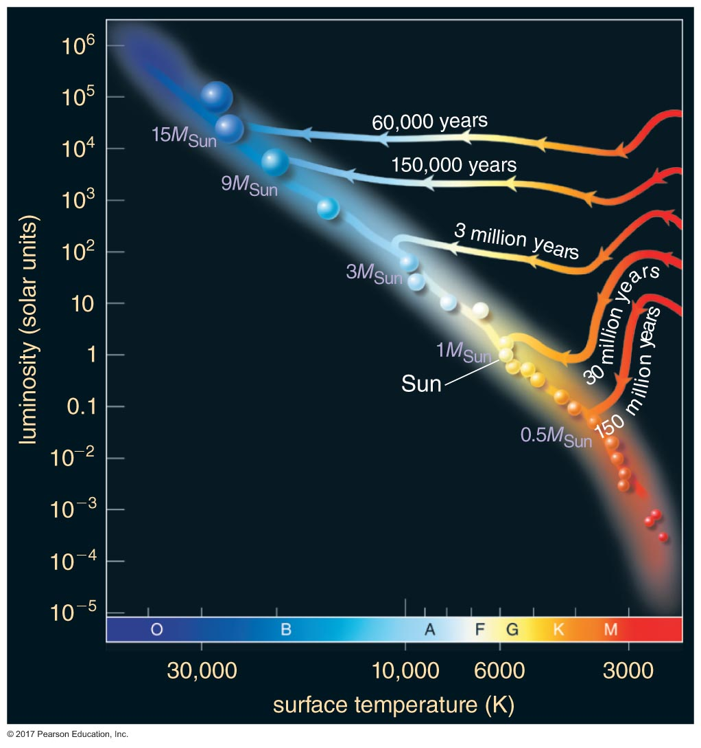
Recap: Time scales for stellar birth
Highest mass stars live the shortest lives
Lowest mass stars live the longest
Notes:
Recap from last class…

Slide 3
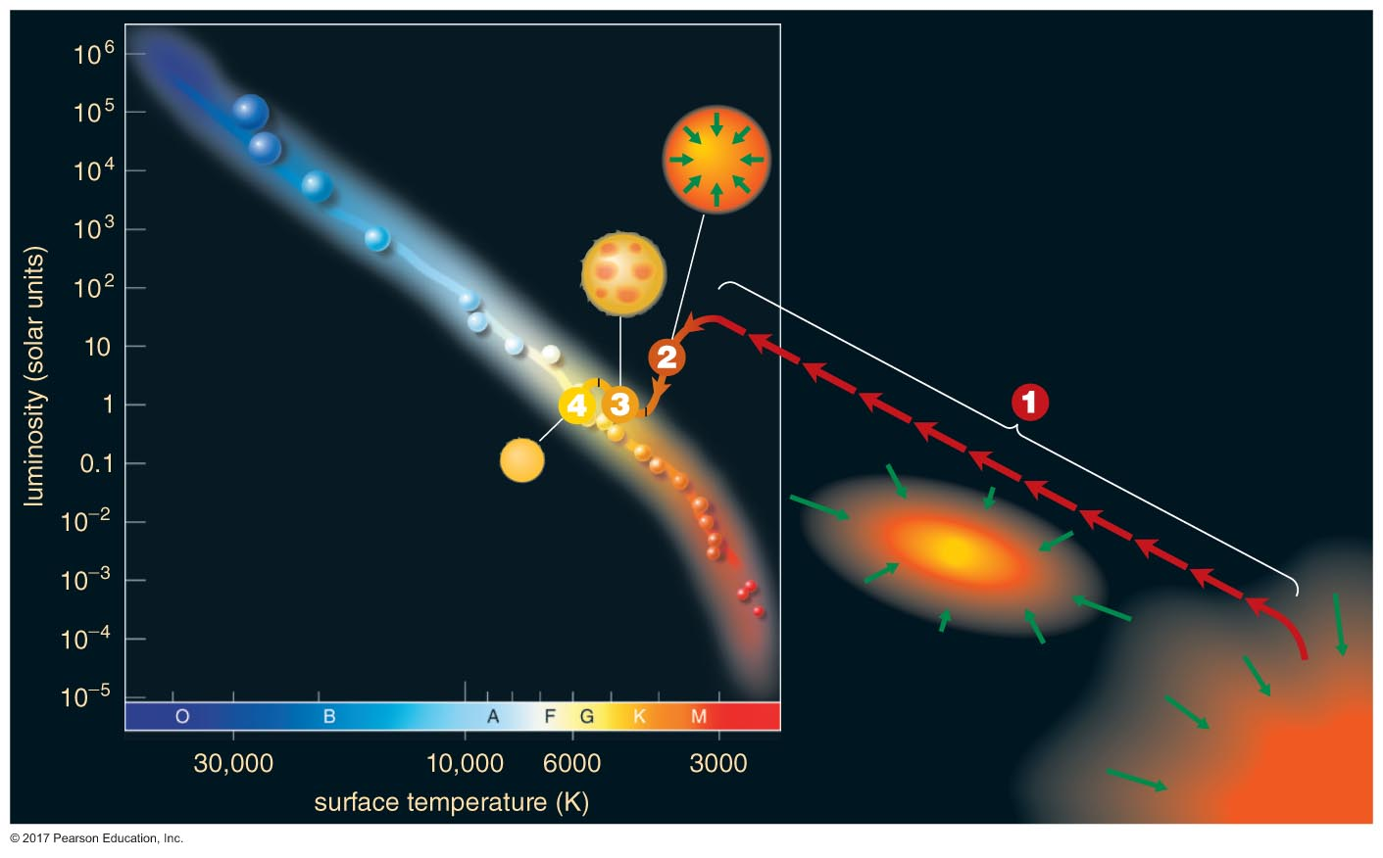
Recap: When does a star become a star?
When it hits a certain temperature?
When it crosses a specific mass threshold?
When it has a disk and can form planets?
When it joins the main sequence: outward pressure from H fusion balances inward force of gravity
Before the main sequence, it is a pre-main sequence star or a protostar.

Slide 4
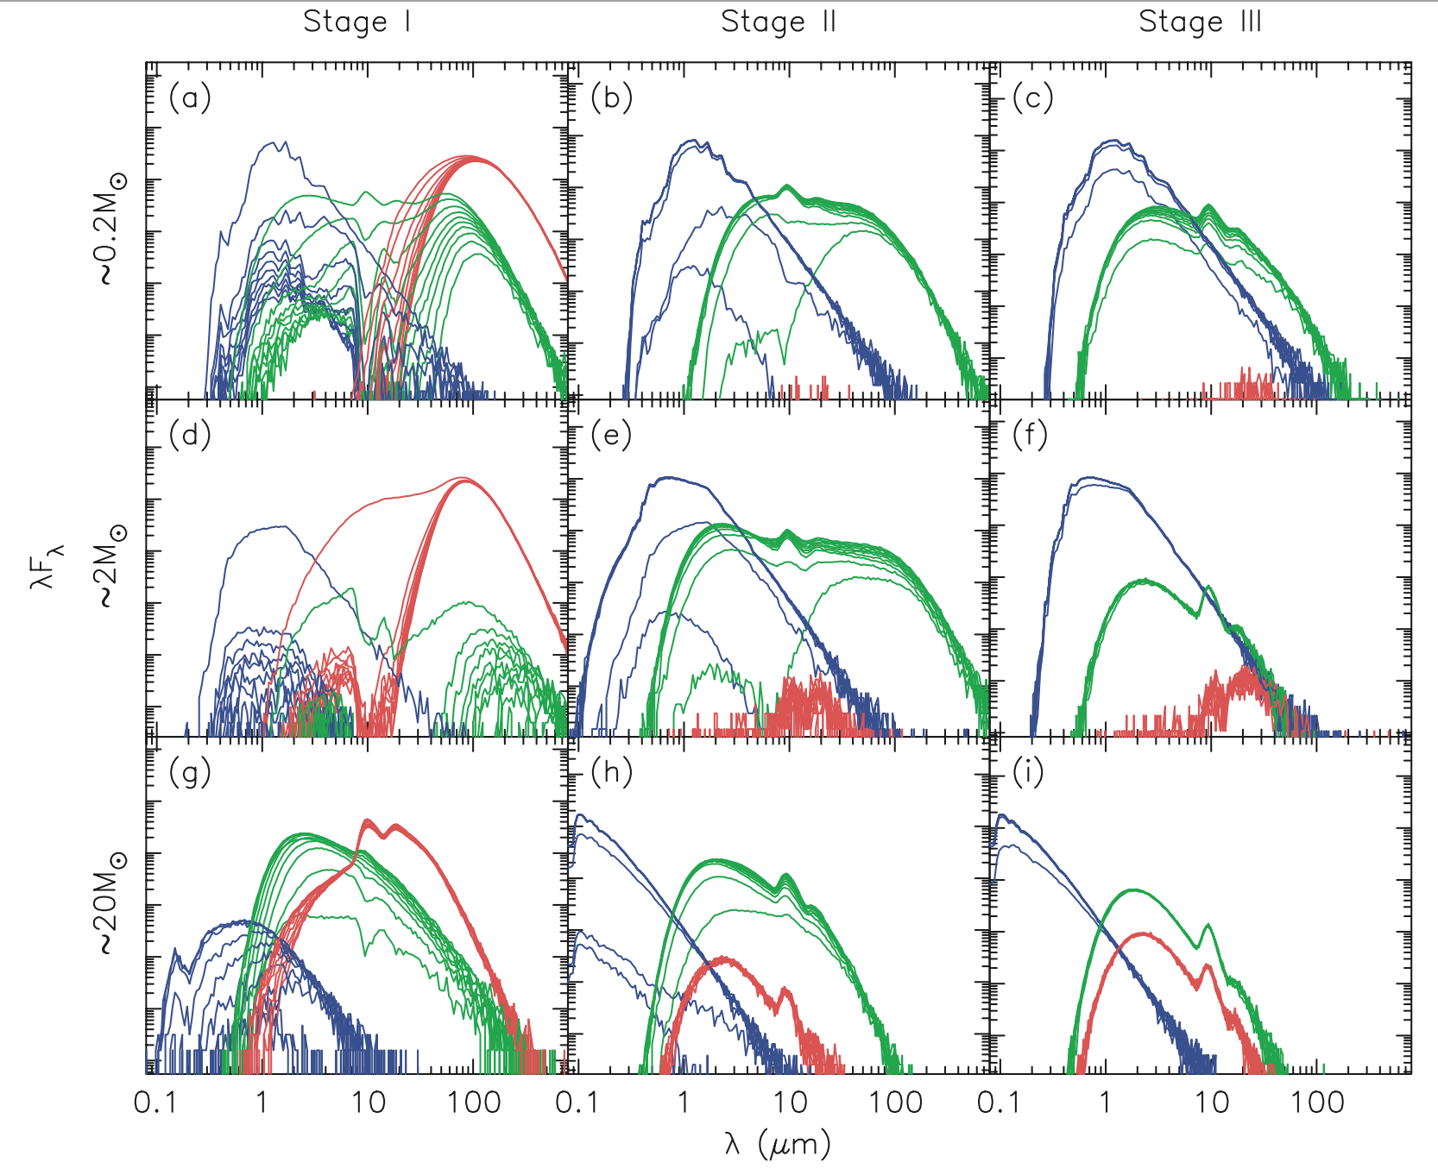
From last class and earlier: spectral energy distributions
Notes:
This is a real figure from a real paper published in the astrophysical journal. You, right now--YES, YOU!--have the knowledge and tools to understand what this graphic is telling us!
The blue is the star, the green is the disk, and the red is the envelope around the star
http://iopscience.iop.org/article/10.1086/508424/pdf

Slide 5
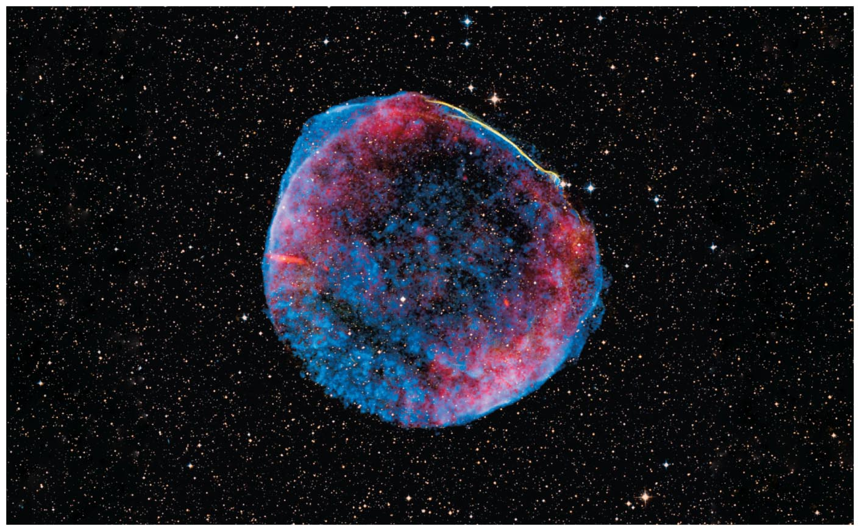
The life cycles of stars
Chapter 17, The Cosmic Perspective

Slide 6
Approaching the main sequence
Gravitational contraction converts gravitational potential energy into thermal energy
Some thermal energy is radiated away, some stays as thermal pressure (dense core is heating up)
At some point, core is dense enough photons don’t escape fast enough to keep the dense core cool
Once temperatures get above ~10,000,000K, H → He fusion begins
The rate that this process happens depends on the star’s mass
The more mass, the faster the density increases to trap in thermal energy and drive temperature up
Fusion produces energy to balance what is being radiated away, energy and pressure finally balanced

Slide 7
A balancing act
Gravity easily stronger than thermal pressure, need fusion to provide additional support for a star against collapse
Stars stay balanced on the main sequence for most of their lives, until H runs out

Slide 8
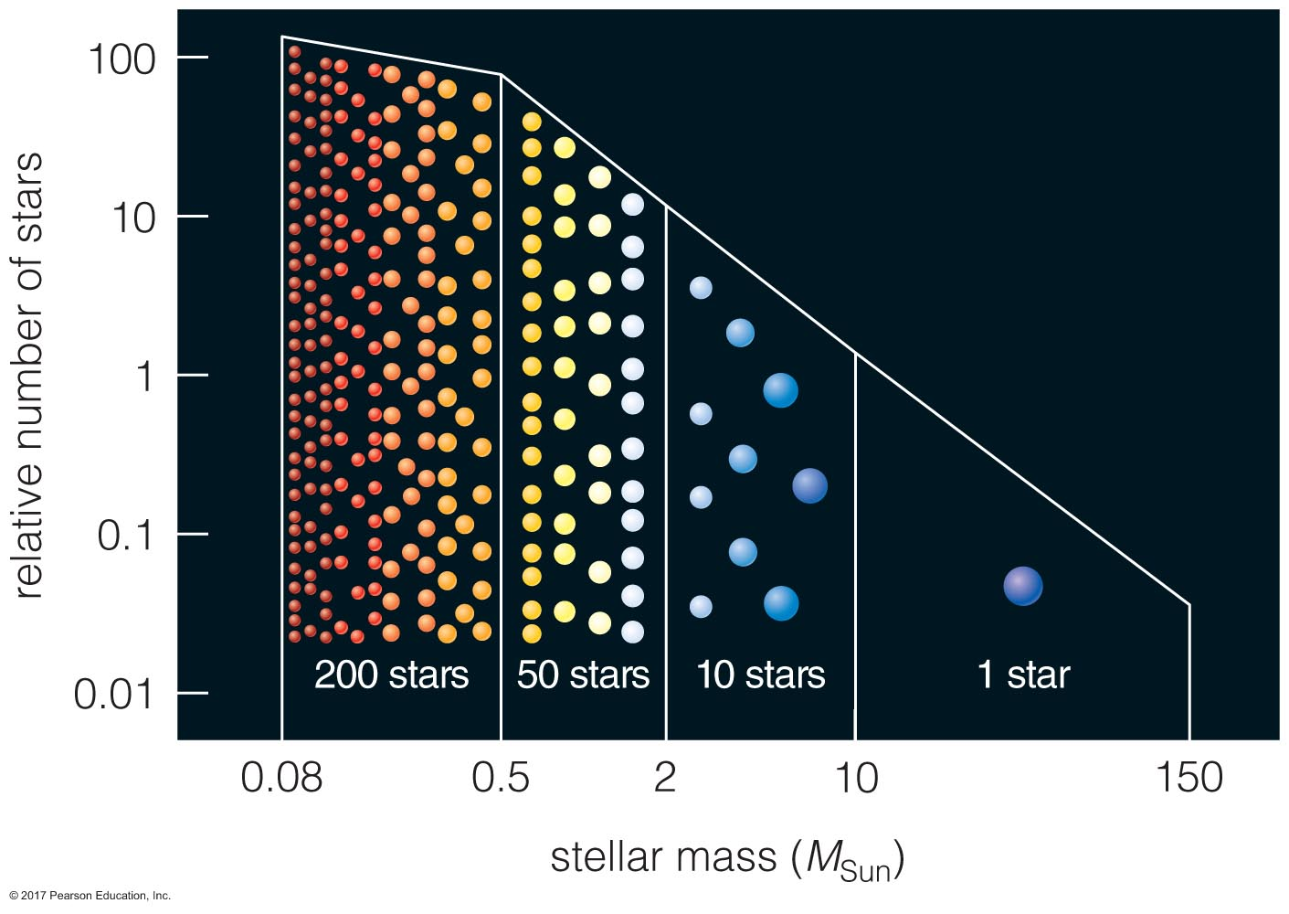
Stellar masses
What is low, intermediate, and high-mass, anyway?
Low mass: < 2 M☉
Intermediate mass: 2-8 M☉
High mass: > 8 M☉
A star’s mass determines what happens to it once it runs out of H to fuse at its core

Slide 9
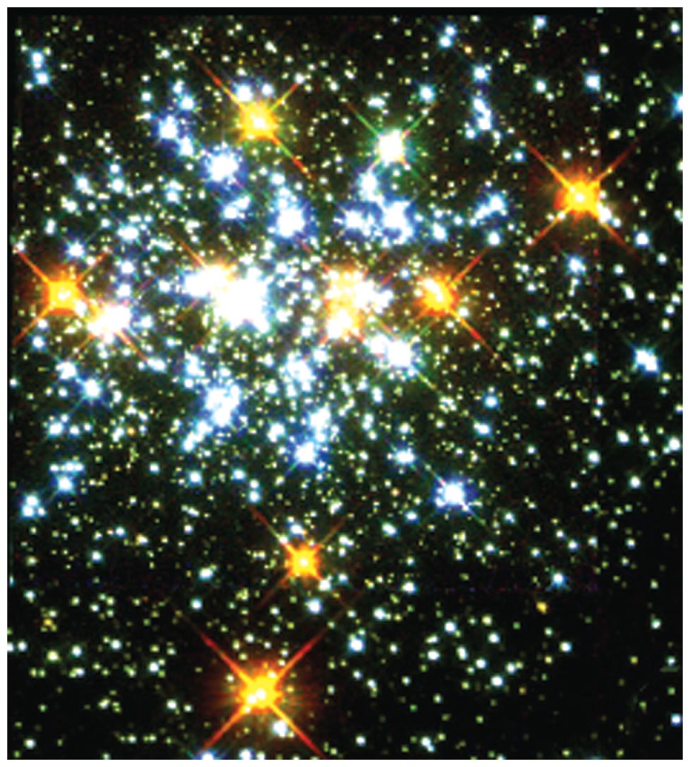
How do we even know about stellar lifetimes, anyway?
We can’t observe a star over its whole life…
…so we observe clusters of stars that are different ages!
Notes:
Star cluster ngc 1818, about 50Myr old. It has intermediate-mass main sequence stars, but the high-mass stars are on the giant branch already

Slide 10
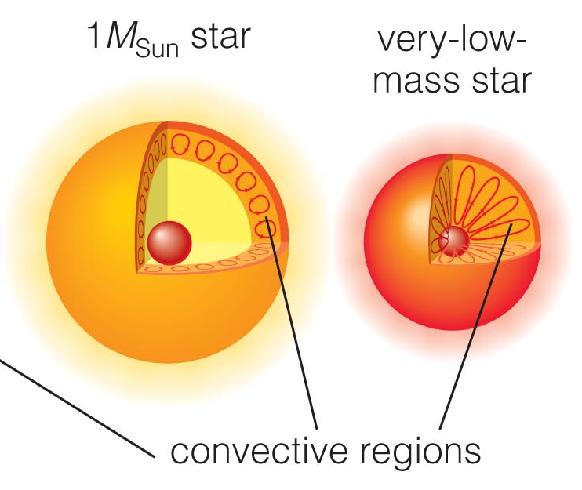
The life of a low-mass star
Stellar mass, core temperature (rate of fusion), determine the interior structure of stars
In the Sun’s radiative zone, plasma so dense, photons pass through (scattering, absorbing/being re-emitted) before plasma even flows
Cooler, less dense upper layers move more easily
As stars churn about inside, they’re also rotating
Young stars rotate more rapidly than older stars
Rotation, stars’ interiors, related to how much magnetic activity we observe

Slide 11
The life of a low-mass star: red giant phase
Let’s consider what will happen when the Sun runs out of H to fuse at its core
Remember that the center of the Sun is the most dense part: the core will start to contract
As the core contracts, it heats up, beginning fusion of the hydrogen that was outside of the core and never burned
Hydrogen shell fusion
Because of this new round of fusion, the Sun’s core will contract while the shell burning H makes the Sun’s outer layers expand
Meanwhile, the shell produces He that adds to the Sun’s core’s mass
Under contraction, the shell keeps getting hotter and fusing faster, and the Sun’s outer layers keep puffing up
Cool side effect: larger radius = lower escape speed! Stellar wind gets stronger and stronger
Notes:
When we say “run out of hydrogen” what we’re really saying is the amount available at the center to keep feeding fusion goes down enough that fusion slows down

Slide 13

Balance lost…
Notes:
This giphy wins for the best hashtags.. I was searching for balance. But this kinda applies to stars- balanced, and then when imbalanced, they all slide to one side, which is like how gravity starts to win and start compression inside a star once fusion slows/stops

Slide 14
The life of a low-mass star: the giant branch
Sun-like stars:
At 100,000,000K+ temperatures,
Nuclei moving much faster in the core and colliding at higher speeds
High speeds allow He nuclei to overcome strong force, and…
Helium-four fuses into Carbon-twelve
3 ⁴He → ¹²C
Very low-mass stars:
Much slower evolution: no stars as K, M on main sequence that have become giants yet (15 billion+ year main sequence lifetimes)
Theoretical models predict:
Degeneracy pressure will stop collapse of Helium core before hot enough to fuse helium
Will become Helium white dwarfs

Slide 15
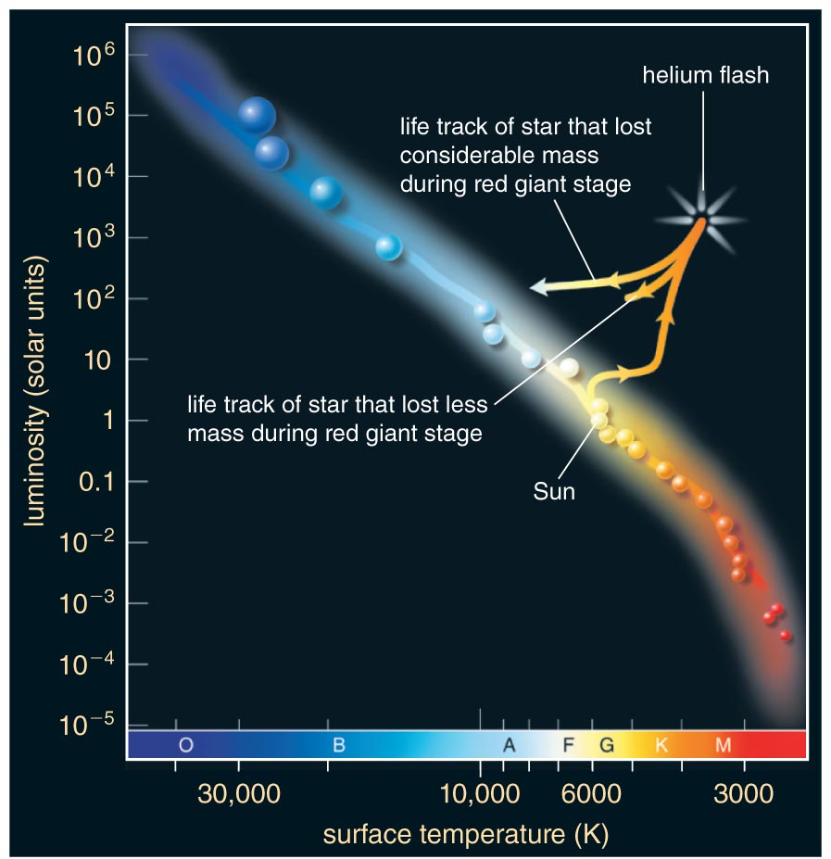
Back and forth; expand, contract
After ~1 billion years, He fusion begins with a flash…
Like in the lowest mass stars, He core is at some point supported against further collapse by degeneracy pressure
Collapsing core and shell cross 100,000,000K temperature threshold, He fusion begins in basically most dense region of He nuclei possible: ka-boom!
Helium flash
He core heats extremely quickly, expands, pushes H-fusing shell out so far it cools, H fusion slows
Notes:
So the Sun will spend about 9 billion years on the main sequence. Then it will take another billion years expanding to as big as it’s going to get as a giant,

Slide 16
Back and forth; expand, contract
Because rate of fusion slows, sun-like giant star begins to contract again
Surface heats up, changes color from red to yellow
Contraction will continue until F_{g} balances the inner outward pressure from He core fusion, H shell fusion
At this point, is the Sun still a Sun?
Maybe not! Depends on how much mass it lost to increased stellar wind!
Notes:
This emphasizes a really important point: a star’s spectral type can change during its life depending on its surface temperature and thus the spectrum it produces. When the Sun was young, it looked like a K-type star, whereas today it’s a G type star.
Note, Betelgeuse is classified as an M star, but it’s a giant! We know no star that’s an M star on the main sequence has ever made it to the giant branch because it takes longer than the age of the universe.

Slide 17
Paths on the H-R diagram
Stars that lose a lot of mass to winds end up having smaller radii
Less luminous
The longer a star has a H-burning shell phase, the more puffed up its radius gets (and thus the more luminous it gets: L=4πr²σT⁴)
You can probably guess what’s next... What about when the He runs out in the core?
After about 100,000 years…

Slide 18
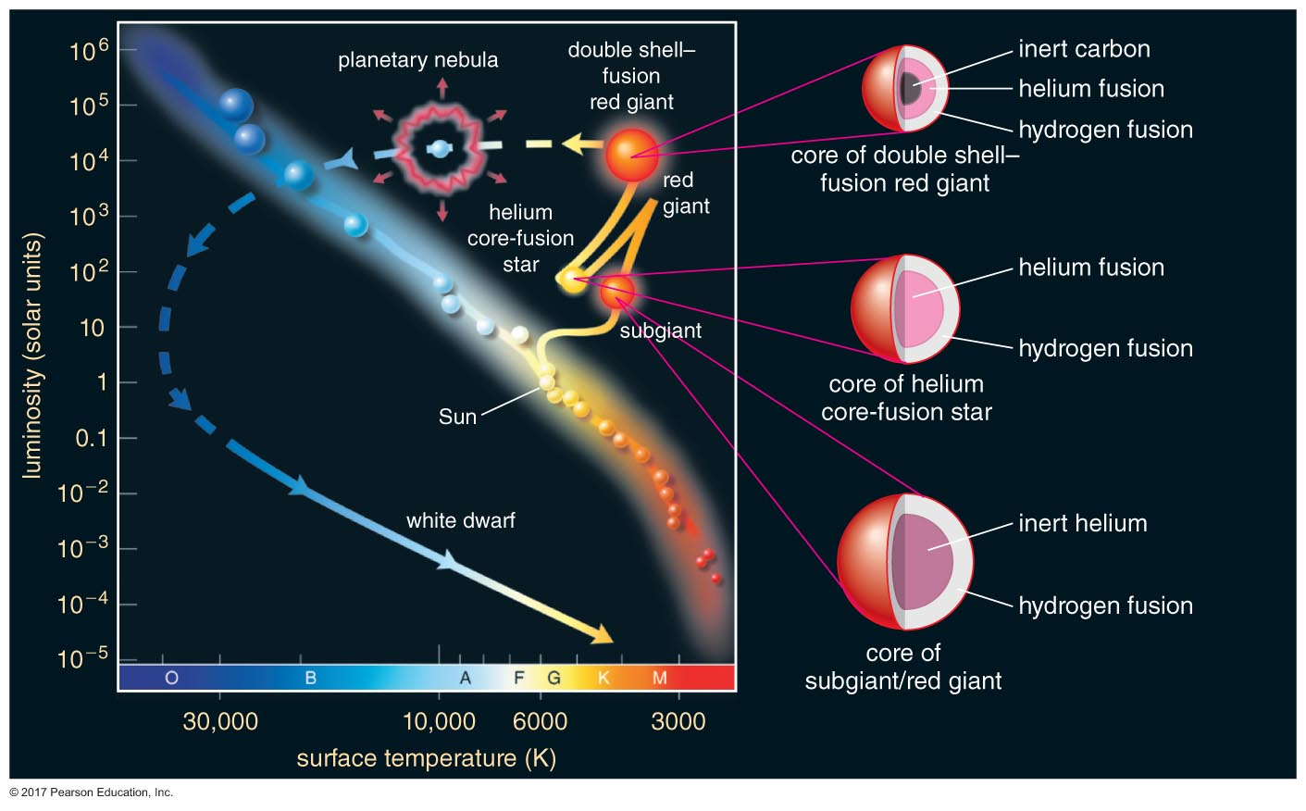
H shell burning, He shell burning, inert C core
Notes:
Now, you have two different shells of burning that respond to the contraction of the Carbon core by both increasing rates of fusion. The outer layers puff out again..

Slide 19
Instability inside, windy outside
Over the next ~1 million years,
contraction continues in core (limited by degeneracy pressure of C),
He and H-fusing shells continue to fuse, but unsteadily
no equilibrium state is reached
outermost layers of the atmosphere are now so far away, very weak F_{g} between core, “surface” of star
Carbon, dredged up in Helium shell’s pulses, ends up pushed outward to star’s surface, flows out in wind; bits clump together, forming dust
Notes:
https://www.skyandtelescope.com/astronomy-news/sun-might-have-formed-giant-stars-bubble/

Slide 20
Poof…
Notes:
Could be many poofs, not just one big one (asymmetries in the PN)
Helix nebula (left)
https://www.spaceanswers.com/news/planetary-nebulae-get-much-more-meaningful-physical-appearance/

Slide 21
Planetary nebulae
Through pulses and winds, outer layers of giant’s atmosphere are ejected
Called a planetary nebula (a terrible name..)
If encountering no resistance, atmosphere travels away from star (escapes), carrying on at its original velocity
For many stars, winds moving faster at the poles than the equator; their planetary nebulae can trace out this shape
Butterfly Nebula is one of the strangest planetary nebulae: did the disk block material from being ejected at star’s equator?
Notes:
https://www.esa.int/spaceinimages/Images/2014/10/Butterfly_death_throes

Slide 22
Planetary nebulae
Exposed carbon core left behind = white dwarf
White because it’s so hot! Used to be the core of the star, a lot of thermal energy remains
Carbon degeneracy pressure keeps core from collapsing further

Slide 23
Planetary nebulae
Exposed carbon core left behind = white dwarf
White because it’s so hot! Used to be the core of the star, a lot of thermal energy remains
Carbon degeneracy pressure keeps core from collapsing further
White dwarf gradually radiates away thermal energy, growing ever dimmer with time
Nebula expands, no longer visible after ~100,000 years

Slide 24
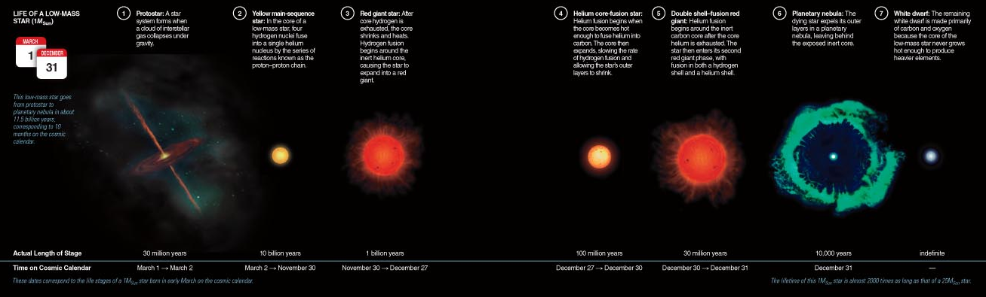
Timescales in context

Slide 25
Sooo.. Uh. Cool. What about us?
We are toast! In about a billion years, maybe
1-5 billion years from now: subtle increase in Sun’s luminosity will be enough to cause runaway greenhouse effect, make oceans boil
At 5 billion years from now, luminosity will have increased up to 1000x present just before helium flash. This will heat Earth to about 1000K
After another 100 million years, once helium core fusion ends, Sun’s surface will expand to about Earth’s orbit

Slide 26
Bummer.
Or is it?
Check out the Special Topic on page 543. Considering it took about 65 million years for humans to get to our present stature after dinosaurs’ extinction event, there are nearly 80 more 65 million year intervals between now and when the Sun will !
Next class: the life of high-mass stars!

